Slide 1


Big Data Analysis of the Enron Email Dataset
Course
DSC 473 – Programming for Big Data
Dataset
Enron Email Dataset
Tools
Docker, Hadoop, HDFS, Apache Spark, PySpark
Leveraging Hadoop & Apache Spark
Presented By
Meshal Al-baiji– 2220004283
Sultan Ghazi– 2220004385
Abdullah Abdulrazzaq– 2220002584

Slide 2

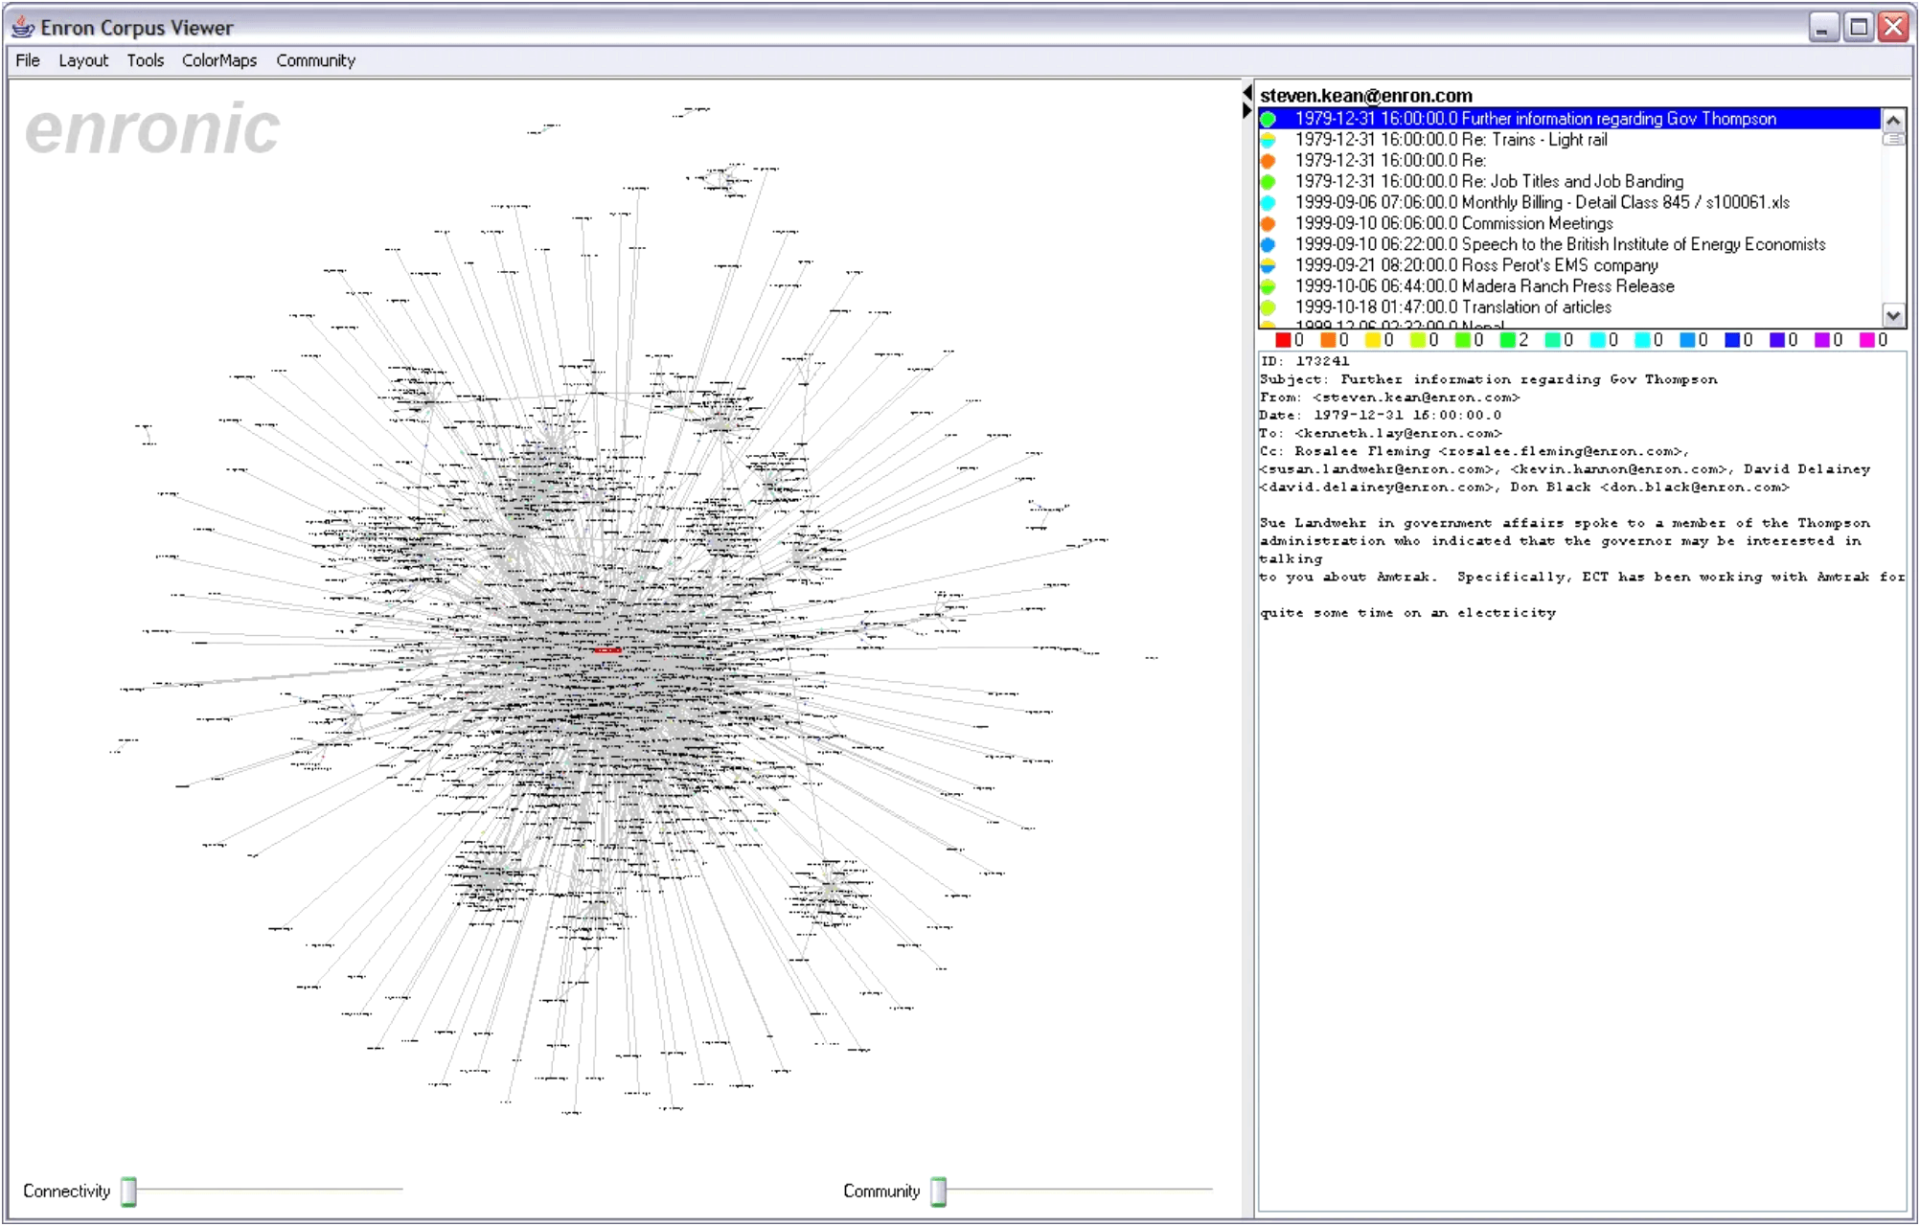
The Enron Email Dataset: A Real-World Big Data Challenge
What is it?
Over one million email messages exchanged within Enron Corporation.
▸
A publicly available, complex, and unstructured dataset.
▸
Why analyze it?
Scale: Exceeds the minimum threshold for Big Data analysis (> 2 GB).
▸
Complexity: Stored across thousands of files, ideal for distributed processing.
▸
Insight: Enables analysis of communication patterns and word frequency.
▸

Slide 3
Key Project Goals
Data Ingestion
Distributed Processing
Import large, unstructured datasets into HDFS for distributed storage and accessibility.
Utilize Apache Spark for high-speed, scalable data processing across the cluster.
Core Analysis
Output
Perform Word Frequency Analysis across the entire dataset to uncover patterns.
Export results into structured, reviewable formats for further analysis and reporting.

Slide 4
Building the Big Data Pipeline
1. Cluster Setup
Deployed a Hadoop cluster using Docker with the following components:
• NameNode

Slide 5
Handling Unstructured Text
The Challenge
Emails are unstructured text files with inconsistent formatting, unnecessary blank lines, and mixed content types that require careful preparation before analysis.
The Solution: Data Cleaning Actions
Action 1
Action 2
Tokenization
Filtering
Split each email into individual words for granular analysis:
Remove blank or null tokens to ensure data quality:
explode(split(col("value"), " "))
filter((col("word") != "") & col("word").isNotNull())
Result
Empty tokens were successfully removed
✓
Only valid words were used for subsequent analytics
✓

Slide 6
Uncovering Communication Patterns
Analytical Goal
Identify the most frequently occurring words across the entire Enron dataset.
▸
This reveals common structures and communication focus within business emails.
▸
Processing Steps
1
Grouping
Group the cleaned words by unique values to prepare for aggregation.
2
Counting
Count the occurrences of each unique word across all email records.
3
Sorting
Order the results in descending count to identify the most frequent words.
word_counts = words_clean.groupBy("word")
.count().orderBy(col("count").desc())

Slide 7
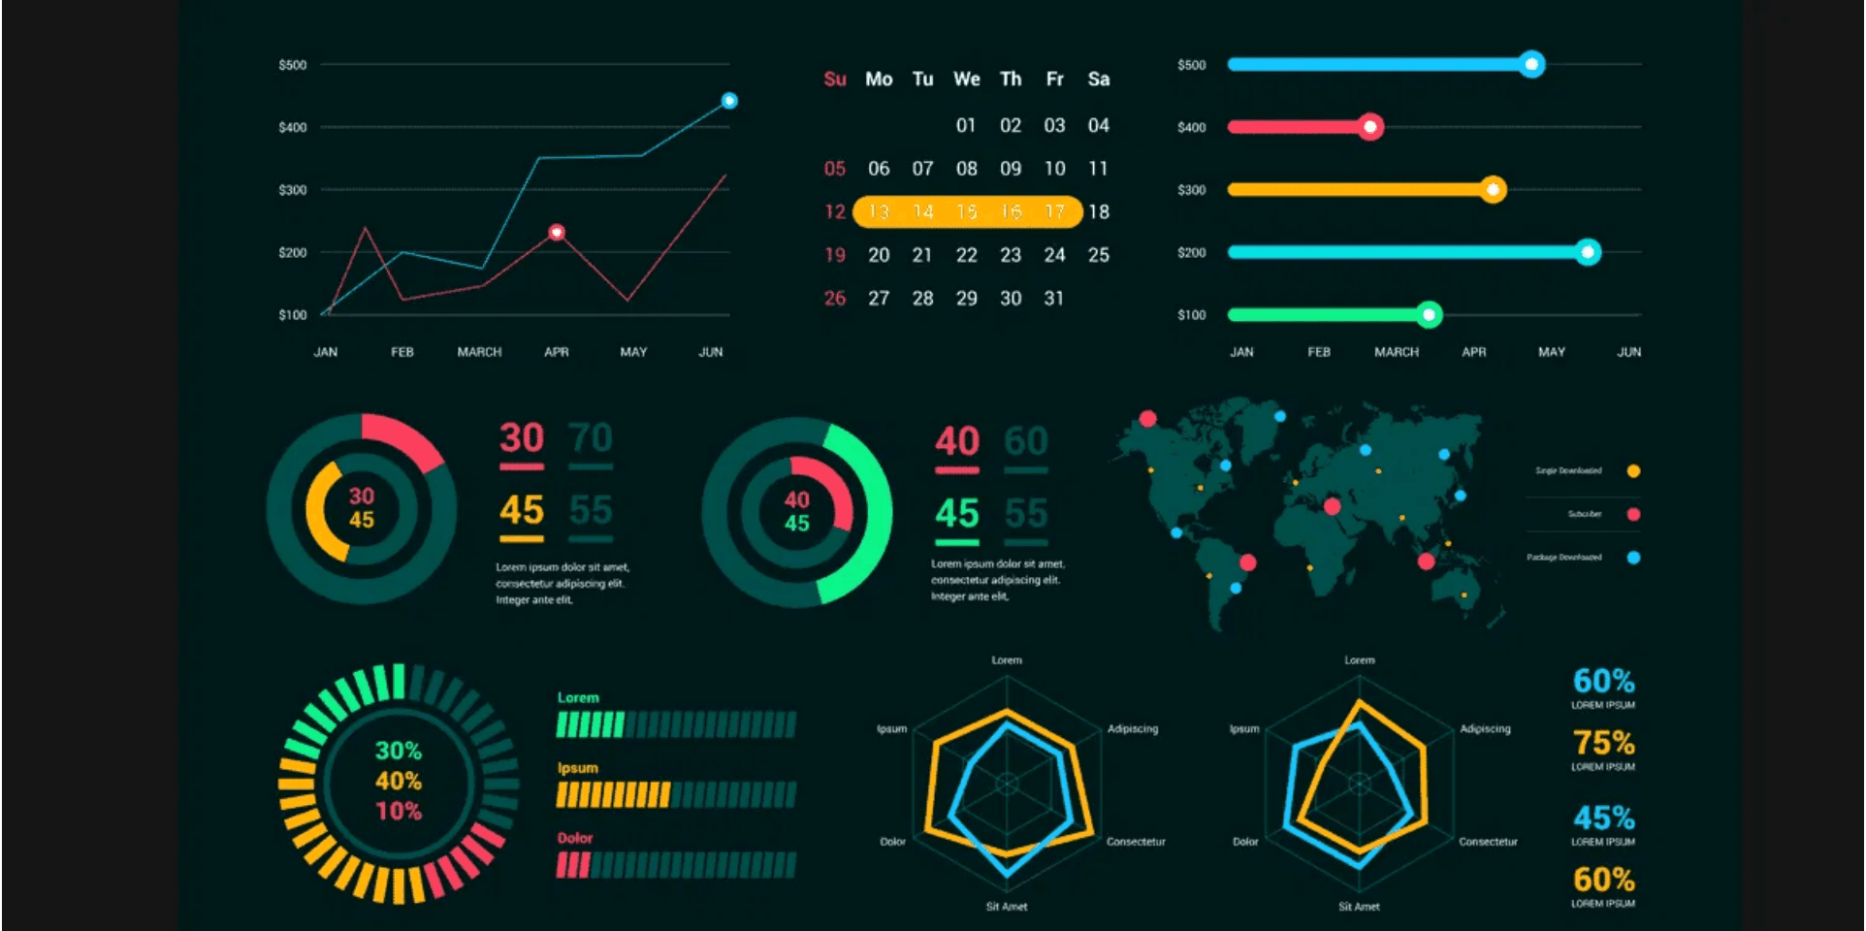
Results of Word Frequency Analysis
Finding 1
Stop Words Dominate
Common English words (the, to, and, of) are most frequent, requiring further removal for semantic analysis.
Finding 2
Metadata Prevalent
Email headers (Subject, To, From, Date, Mime-Version, Content-Type) repeat for every email, heavily influencing word distribution.
Finding 3
Textual Noise
Symbols and formatting characters (e.g., >, -) appear frequently, indicating the need for more aggressive text normalization.

Slide 8

Overcoming Technical Hurdles
Challenge
Solution Implemented
Docker Permissions
Switched to root user and applied permissions using:
Container permission errors during output directory creation
chmod -R 777 /data
HDFS Endpoint
Reconfigured Spark to use the correct Hadoop default file system address:
Spark failed to locate the HDFS endpoint
hdfs://hadoop-namenode-1:9000
Large Data Handling
Leveraged Spark's in-memory distributed processing to efficiently batch-process the entire dataset
Processing over one million text records efficiently
Text Noise
Filtered null and empty tokens to normalize word extraction and improve data quality
Inconsistent formatting and textual noise in raw emails

Slide 9
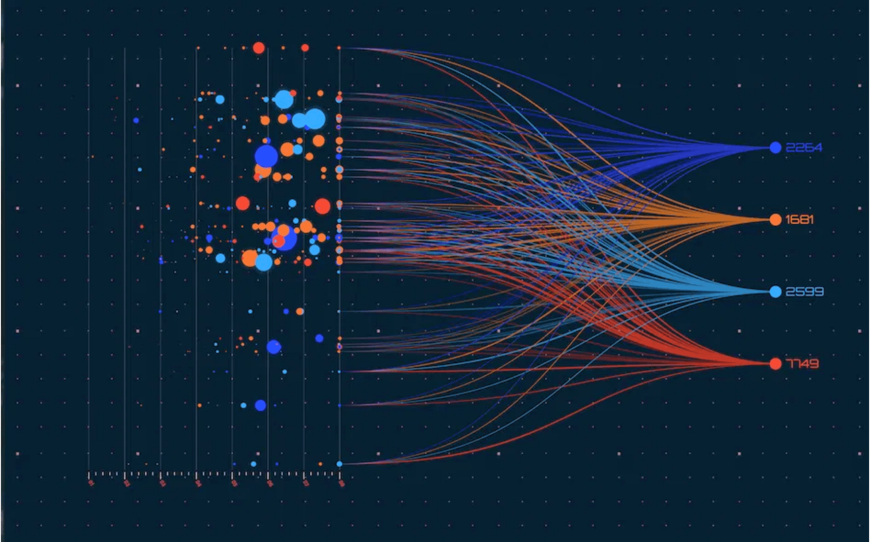
Project Summary
Successes
Successfully implemented a complete Big Data pipeline using HDFS and Spark.
✓
Processed over 1 million unstructured email records using PySpark efficiently.
✓
Performed a scalable Word Count analysis and exported results in structured formats.
✓
Key Takeaway
Email datasets require advanced preprocessing to filter out heavy metadata and stop words for deeper, meaningful insights.

Slide 10

Thank You
Any Questions?
Meshal Al-baiji • Sultan Ghazi • Abdullah Abdulrazzaq

